Slide 1
Title
Second-Hand Book Marketplace for Students
Presenters
ROJIN GHIMIRE
PRASHANT KARKI
SHASWAT POKHREL
SUBARNA BAHADUR SHAHI
Under Supervision of Sanju Shrestha

Slide 2
OUTLINE
Introduction
Problem Statement
Literature Review
Objectives
Methodology
Feasibility
Gantt Chart
Tech Stack
Comparison
Conclusion

Slide 3
Introduction
The cost of academic textbooks has been increasing steadily, making it difficult for many students to afford new books every semester. In most cases, these books are used only for a short period and then remain unused, leading to both financial burden and wastage of resources. Despite this issue, there is no proper or trusted platform in Nepal where students can easily buy and sell second-hand books. This creates a gap between students who want to sell their used books and those looking for affordable alternatives. Therefore, this project aims to develop a second-hand book marketplace that connects students, reduces costs, and promotes reuse in an efficient and reliable way.

Slide 4
Problems / Challenges
High cost of textbooks for students
Lack of centralized resale system
Difficulty in finding specific books
Risk of damaged or overpriced books
No proper trust or verification mechanism

Slide 5
Motivation
To reduce the financial burden on students
To promote reuse and reduce waste
To create a trusted student-focused platform
To make books more accessible and affordable

Slide 6
Literature Review
BooksMandala – focuses mainly on new books, limited resale options
Daraz – general e-commerce platform, not specialized for books
Facebook Marketplace – informal system, lacks trust and verification
ThriftBooks / AbeBooks – global platforms, not localized for Nepal

Slide 7
Objectives
Develop a user-friendly resale platform
Enable easy buying and selling of books
Ensure trust through ratings and reviews
Provide affordable learning resources
Encourage sustainable practices

Slide 8
Methodology
Users register and log in to the system
Sellers upload book details (price, condition, images)
Buyers search and filter books based on needs
Buyers contact sellers through platform
Transaction is completed and feedback is given

Slide 9
Feasibility
Technical: Can be implemented using standard web technologies
Economic: Low cost as it requires minimal infrastructure
Operational: Easy to use for students with basic internet access
Time: Project can be completed within given semester duration

Slide 10
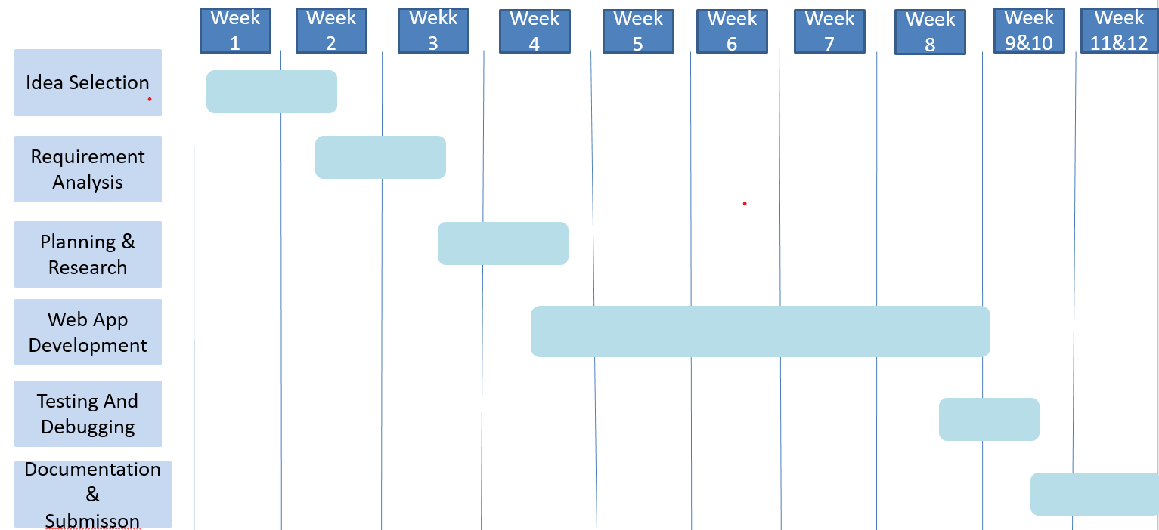
Gantt Chart

Slide 11
Tech Stack
Frontend: HTML, CSS, JavaScript
Backend: PHP or Node.js
Database: MySQL
Tools: VS Code, GitHub

Slide 12
Comparison
International Platforms (ThriftBooks, AbeBooks) → Large variety of books globally → High delivery time and cost in Nepal → Not focused on local student needs
Local Platforms (BooksMandala, Daraz, Facebook Marketplace) → Mostly sell new books or general products → No proper system for resale, trust, or verification → Informal and not student-focused
Proposed System (Our Project) → Designed specifically for students in Nepal → Direct buyer-seller interaction → Low cost and faster exchange → Includes ratings and condition-based system

Slide 13
Conclusion
The proposed system provides a practical and effective solution to a common problem faced by students. It helps reduce the cost of education by enabling students to buy and sell second-hand books at affordable prices. At the same time, it promotes the reuse of resources, reducing unnecessary waste.
By offering a simple, reliable, and student-focused platform, the system improves accessibility to study materials and builds trust between buyers and sellers. Furthermore, the project has strong potential for future expansion, such as integrating online payments, delivery services, and mobile applications, making it a scalable solution for real-world implementation in Nepal

Slide 14
THANK YOU…

